Slide 1
The Machine Learning Paradigm
From coding to learning...
Laurence Moroney, Google

Slide 2
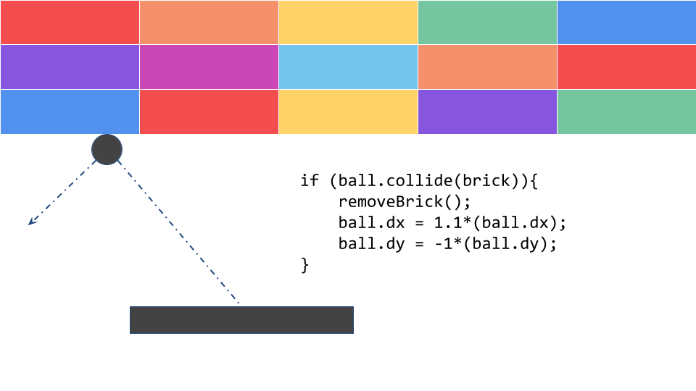
Explicit Coding
Defining rules that determine behavior of a program
Everything is pre-calculated and pre-determined by the programmer
Scenarios are limited by program complexity

Slide 3
The Traditional Programming Paradigm
Rules
Traditional Programming
Answers
Data

Slide 4
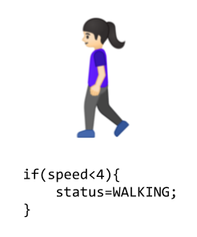
Consider Activity Detection

Slide 5
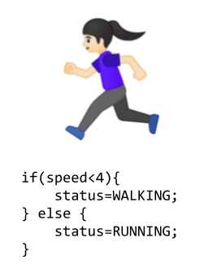
Consider Activity Detection

Slide 6
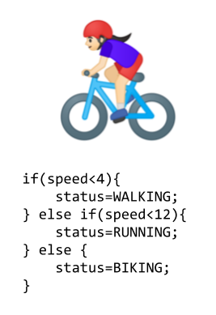
Consider Activity Detection

Slide 7

Consider Activity Detection

Slide 8
The Traditional Programming Paradigm
Rules
Traditional Programming
Answers
Data

Slide 9
The Machine Learning Paradigm
Answers
Machine Learning
Rules
Data

Slide 10
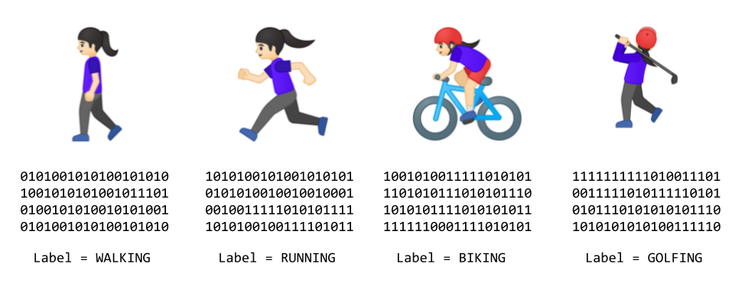
Activity Detection with Machine Learning

Slide 11
The Machine Learning Paradigm

Slide 12
The Machine Learning Paradigm

Slide 13
The Machine Learning Paradigm
Make a Guess!

Slide 14
The Machine Learning Paradigm
Make a Guess!
Measure your accuracy

Slide 15
The Machine Learning Paradigm
Make a Guess!
Measure your accuracy
Optimize your Guess

Slide 16
The Machine Learning Paradigm
Make a Guess!
Measure your accuracy
Optimize your Guess
Repeat

Slide 17
The Machine Learning Paradigm
Labels
Machine Learning
Rules
Data

Slide 18
The Machine Learning Paradigm
Answers
Machine Learning
Rules
Data
Model
Data
Inferences

Slide 19
Your turn!

